Slide 1
Java EE – Data Source Layer revisited

Slide 2
Pattern categories mapped to layers
Model View Controller
Page Controller
Web Presentation Patterns
Session State Patterns
Data Transfer Object (DTO)
Presentation
Domain
Data Source
Domain Model
Service Layer
Distribution Patterns
Object-Relational Behavioral Patterns
Object-Relational Structural Patterns
Object-Relational Metadata Mapping Patterns
Domain Logic
Patterns
Table Data Gateway
Offline Concurrency Patterns
Data Source Architectural Patterns
Object-Relational … Patterns
Notes:
De patterns in de gele blokjes gaan we actief gebruiken. Alleen kort opsommen voor een globale indruk van de studenten, later in detail bespreken als we per laag gaan realiseren.

Slide 3
Data Source Layer
Communication with databases, messaging systems, transaction managers, other packages or external systems
We’re going to focus on (relational) databases.

Slide 4
Patterns
Object-Relational Behavioral Patterns
Unit of Work
Identity Map
Lazy Load
Object-Relational Metadata Mapping Patterns
Metadata Mapping
Query Object
Repository
Object-Relational Structural Patterns
Identity Field
Foreign Key Mapping
Association Table Mapping
Dependent Mapping
Embedded Value
Serialized LOB
Single Table Inheritance
Class Table Inheritance
Concrete Table Inheritance
Inheritance Mappers

Slide 5
JDBC
What’s wrong with?

Slide 6
JDBC
“Java Database Connectivity”
Java SE library for querying/updating database data
Mainly focused on relational DBs
Manages Connections to the DB, either directly or through a 3rd party “Connection Pool”
Database vendors provide their own JDBC driver libraries

Slide 7
JDBC (cont'd)
API abstracts common interactions, data types, etc.
Execute SQL through “Statements”
Query returns received through “ResultSets”
Transactional
Cacheable

Slide 8
Domain Model Pattern
Focus on business concepts, not relational DB structure
Interconnected objects
Each object is a meaningful individual/concept
OO concepts: inheritance, object identity, etc.
Navigate data by walking the object graph, not the explicit relational model

Slide 9
Object Relational Mapping
ORM

Slide 10
Why ORM?
Increased development speed & reduced code
No “by-hand” mapping of JDBC ResultSets to POJOs
Less work synchronizing code with relational DB changes
Less JBDC boilerplate (repetitious CRUD)
Focus on business logic

Slide 11
Why ORM? (cont'd)
Portability
Mostly DB independent (exception: some types of features, identifier generation, etc.)
Query abstractions (OO APIs, OO-structured languages, etc.)
Vendor-specific SQL is auto generated

Slide 12
Why ORM? (cont'd)
Performance
Granular control of “when”, “how”, “how much” data/relationships to load, based on the business logic
Object and query caching
Concurrency & multiple-tenancy
Transactional
Scalable
Extendable (many types of extension points)

Slide 13
ORM in Java: JPA & Hibernate
The principle of ORM involves delegating access to relational databases to external tools or frameworks.
Mapping tools give an object-oriented view of relational data, and vice versa.
Hibernate framework gave a lightweight, object-oriented persistent model.
JPA is now considered the standard industry approach for Object to Relational Mapping (ORM) in the Java Industry.
Proprietary
API, Standard

Slide 14
ORM (cont.): JPA & Hibernate
JPA itself is just a specification, it only describes persistence concepts and provides standard interfaces.
Any Java EE 5 (and above) application server should provide support for its use.
The latest JPA specification version is JPA 2.1 .
There are open-source and commercial JPA implementations:
Hibernate (acquired by JBoss, acquired by Red Hat),
TopLink (Oracle),
OpenJPA (Apache project),
EclipseLink (Eclipse Foundation project).
EclipseLink was announced to be the JPA 2.0 reference implementation.

Slide 15
Entities
Uses lots of Fowler’s patterns as we’ll see in this lecture
Object that maps to relational database table will be called Entity and once mapped it can be managed by JPA .
JPA maps entities to a database through metadata using two formats:
Annotations: the entity class is directly annotated with annotations.
XML descriptors: The mapping is defined in an external XML file.
The entity name is mapped to a relational table name.
Attribute names are mapped to a column name.
Entity must define a primary key (single field or a combination of fields).

Slide 16
Entities (cont.)
The default mapping rules are different from one database to another.
It’s possible to map a single entity to several tables.
Operations can be made on entities are persisting, updating, removing, and loading.
Entities are just POJOs when they managed by Entity Manager their state is synchronized with the database .
When entities detached from the entity manager they can be used like any other Java class.

Slide 17
@Entity
@Entity @Table(name = "items") public class Item implements Serializable { @Id private Integer id; private String sku; private String category; private String title; public Item() { } // getters + setters }

Slide 18
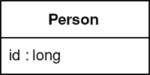
Pattern: Identity Field
Saves a database ID field in an object to maintain identity between an in-memory object and a database row.

Slide 19
@Id
@Entity @Table(name = "items") public class Item implements Serializable { @Id private Integer id; private String sku; private String category; private String title; public Item() { } // getters + setters }

Slide 20
Identity Field generation
Using auto-increment/identity columns
Using sequences
Using table
If you application is going to use only one RDBMS, the first or the second option should be fine (depending on your RDBMS vendor). In other cases, TABLE strategy is preferred, if not the only possible.

Slide 21
Auto Increment
CREATE TABLE JPAGEN_ADDRESS
(
ID INT PRIMARY KEY AUTO_INCREMENT,
CITY VARCHAR(255) NOT NULL,
STREET VARCHAR(255) NOT NULL
);
@Entity
@Table(name = "JPAGEN_ADDRESS")
public class Address implements Serializable {
@Id
@GeneratedValue(strategy = GenerationType.IDENTITY)
private long id;
}

Slide 22
Sequence
CREATE TABLE JPAGEN_ADDRESS
(
ID NUMBER PRIMARY KEY,
CITY VARCHAR(255) NOT NULL,
STREET VARCHAR(255) NOT NULL
);
CREATE SEQUENCE JPAGEN_ADDRESS_SEQ START WITH 100;
@Entity
@Table(name = "JPAGEN_ADDRESS")
public class Address implements Serializable {
@Id
@GeneratedValue(strategy = GenerationType.SEQUENCE,
generator = "addressGen")
@SequenceGenerator(name = "addressGen",
sequenceName = "JPAGEN_ADDRESS_SEQ")
private long id;
}

Slide 23
Table
CREATE TABLE JPAGEN_PERSON
(
ID NUMBER PRIMARY KEY,
NAME VARCHAR(255) NOT NULL,
ADDRESS_ID NUMBER
);
CREATE TABLE JPAGEN_GENERATORS
(
NAME VARCHAR(255) PRIMARY KEY,
VALUE NUMBER
);

Slide 24
Table (cont.)
@Entity
@Table(name = "JPAGEN_PERSON")
public class Person implements Serializable {
@Id
@GeneratedValue(strategy = GenerationType.TABLE,
generator = "personGen")
@TableGenerator(name = "personGen",
table = "JPAGEN_GENERATORS",
pkColumnName = "NAME",
pkColumnValue = "JPAGEN_PERSON_GEN",
valueColumnName = "VALUE")
private long id;
// other fields and methods are omitted
}

Slide 25
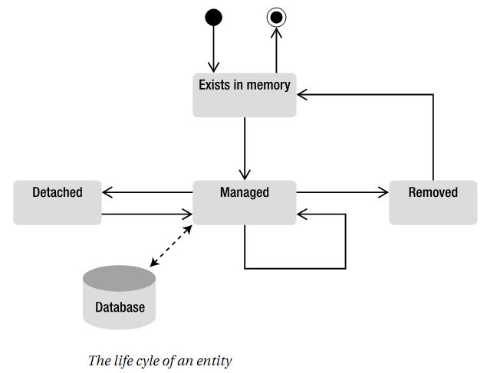
Entities (cont.)
The object is in memory acting as a DTO
Modification on detached object would not be persisted automatically
Developers need to persist detached objects using a primitive

Slide 26
Entity Manager
The central piece of the API responsible for orchestrating entities is the entity manager.
Entity Manager is just an interface whose implementation is done by the persistence provider, e.g. EclipseLink or Hibernate.
It allows simple CRUD operations as well as complex queries using JPQL (Java Persistence Query Language).
Queries can be divided to:
dynamic queries (created dynamically at runtime),
static/named queries (defined statically at compile time),
native SQL statement.
The persistence context describes all Entities of one Entity manager.

Slide 27
Read (Find)
@Inject
private EntityManager em;
...
Query query = em.createQuery("SELECT e FROM Item e");
return (List<Item>) query.getResultList();
JPQL, not SQL

Slide 28
Create
@Inject
private EntityManager em;
...
public void create(Item newEntity) {
em.getTransaction().begin();
em.persist(newEntity);
em.flush();
em.getTransaction().commit();
}
Wrap all modifications in transactions
Detached entity (DTO)
The reason for adding the flush() is that persist() is not clearly guaranteed to have generated the @GeneratedValue

Slide 29
Update
@Inject
private EntityManager em;
...
public void update(Item updatedEntity) {
if(em.find(Item.class, updatedEntity.getId()) == null){ throw new IllegalArgumentException("Unknown Item”)
}
em.getTransaction().begin();
em.merge(updatedEntity);
em.getTransaction().commit();
}
Detached entity (DTO)
Wrap all modifications in transactions

Slide 30
Delete
@Inject
private EntityManager em;
...
public void remove(Item entityToRemove){
if(em.find(Item.class, entityToRemove.getId()) == null){ throw new IllegalArgumentException("Unknown Item”)
}
em.getTransaction().begin();
em.remove(entityToRemove);
em.getTransaction().commit();
}
Detached entity (DTO)
Wrap all modifications in transactions

Slide 31
Database configuration: persistence.xml
We use JPA 2.1. The rest of the stuff is to make this file a valid XML file and validate it using a schema
<persistence xmlns=http://xmlns.jcp.org/xml/ns/persistence
xmlns:xsi="http://www.w3.org/2001/XMLSchema-instance"
xsi:schemaLocation="http://xmlns.jcp.org/xml/ns/persistence
http://xmlns.jcp.org/xml/ns/persistence/persistence_2_1.xsd"
version="2.1">
<persistence-unit name="simpleorder"
transaction-type="RESOURCE_LOCAL">
<provider>
org.hibernate.jpa.HibernatePersistenceProvider
</provider>
<class>
oose.dea.dataaccess.Item
</class>
…
</persistence-unit>
</persistence>
Name for the unit. Can be used when @PersistenceContext is used instead of @Inject
An applicationserver like Glassfish can manage transactions using JTA, Tomcat can’t. We need RESOURCE_LOCAL instead of JTA. You must use the EntityTransaction API to begin/commit around every call to your EntityManger
We use Hibernate as the JPA implementation
Item is managed by JPA.

Slide 32
Database configuration: persistence.xml
<properties> <property name="javax.persistence.jdbc.url"
value="jdbc:mysql://localhost/simpleorder"/> <property name="javax.persistence.jdbc.user" value=”…"/> <property name="javax.persistence.jdbc.password" value=”…"/> <property name="javax.persistence.jdbc.driver"
value="com.mysql.jdbc.Driver"/> <property name="hibernate.show_sql" value="true"/> <property name="hibernate.format_sql" value="true"/> <property name="hibernate.dialect"
value="org.hibernate.dialect.MySQL5InnoDBDialect"/> <property name="hibernate.hbm2ddl.auto" value="validate"/>
… </properties>
JPA properties
Specific MySQL dialect
Hibernate properties
Hibernate can generate a DDL from the list of entities. We use validate here, create will (re)generate the database over and over

Slide 33
Database configuration: persistence.xml
<property name="hibernate.c3p0.min_size" value="5"/>
<property name="hibernate.c3p0.max_size" value="20"/>
<property name="hibernate.c3p0.timeout" value="500"/> <property name="hibernate.c3p0.max_statements" value="50"/> <property name="hibernate.c3p0.idle_test_period" value="2000"/>
Hibernate uses connection pooling. Most of the time the defaults are OK.

Slide 34
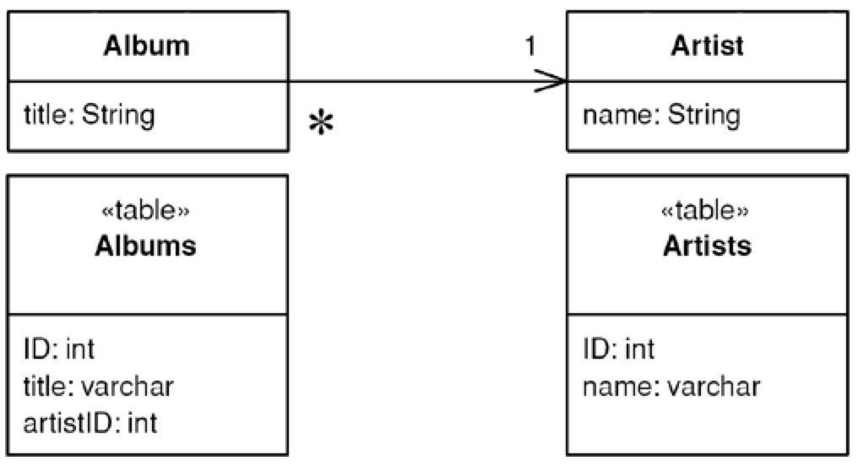
Pattern: Foreign Key Mapping
Maps an association between objects to a foreign key reference between tables.

Slide 35
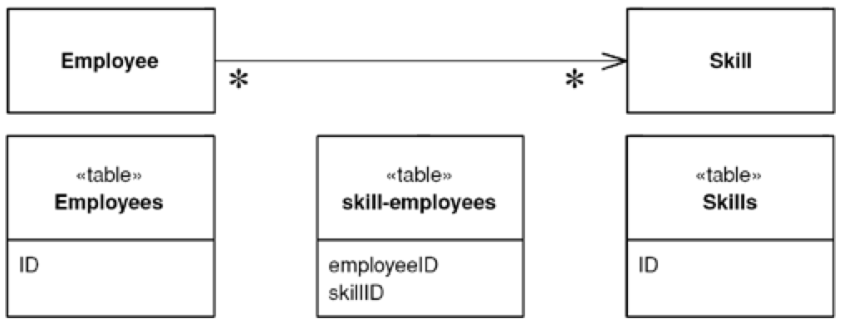
Pattern: Association Table Mapping
Saves an association as a table with foreign keys to the tables that are linked by the association.

Slide 36
JPA Relationships
JPA allows to define relationships between classes (Entities).
A relationship can be bidirectional or unidirectional.
In a bidirectional relationship both classes store a reference to each other while in an unidirectional case only one class has a reference to the other class.
Relationship annotations:
@OneToOne
@OneToMany
@ManyToOne
@ManyToMany
Foreign Key and Association Table Mapping apply here
When you have a ManyToMany with extra properties/columns use 2 OneToMany relationships

Slide 37
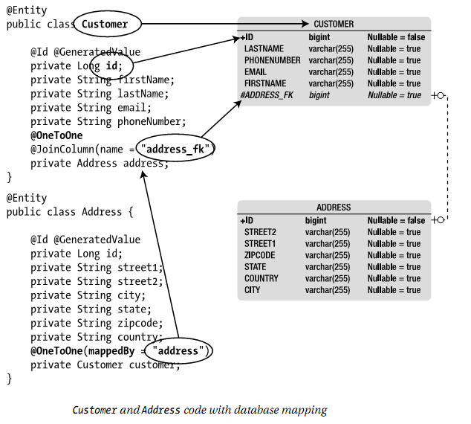
Relationship Mapping

Slide 38
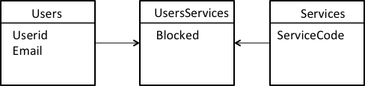
Relationship Mapping: ManyToMany with extra columns

Slide 39
ManyToMany with extra columns
class User {
@OneToMany(mappedBy = "user")
private Set<UserService> userServices = new HashSet<UserService>();
}

Slide 40
ManyToMany with extra columns
class UserService {
@ManyToOne
@JoinColumn(name = "user_id")
private User user;
@ManyToOne
@JoinColumn(name = "service_code")
private Service service;
@Column(name = "blocked")
private boolean blocked;
}

Slide 41
ManyToMany with extra columns
class Service {
@OneToMany(mappedBy = "service")
private Set<UserService> userServices =
new HashSet<UserService>();
}

Slide 42
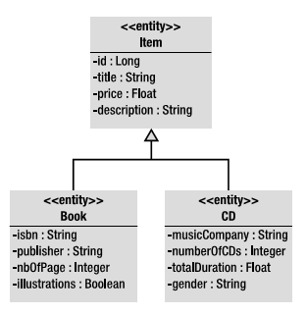
Inheritance Mapping

Slide 43
Inheritance Mapping (cont.)
The root entity class can define the inheritance strategy by using the @Inheritance annotation.
If it doesn’t, the default single-table-per-class hierarchy strategy will be applied.
Inheritance Strategies for JPA:
A single-table-per-class.
A joined-subclass.
A table-per-concrete-class.
Single Table Inheritance Pattern
Class Table Inheritance Pattern
Concrete Table Inheritance Pattern

Slide 44
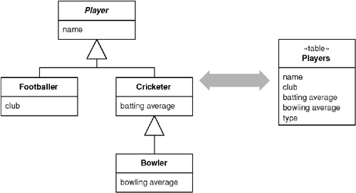
Pattern: Single Table Inheritance
Represents an inheritance hierarchy of classes as a single table that has columns for all the fields of the various classes.

Slide 45
Single Table Inheritance
Strengths
Weaknesses
Fields are sometimes relevant and sometimes not, which can be confusing to people using the tables directly.
Columns used only by some subclasses lead to wasted space in the database.
The single table may end up being too large, with many indexes and frequent locking, which may hurt performance.
You only have a single namespace for fields, so you have to be sure that you don't use the same name for different fields.
There's only a single table to worry about on the database.
There are no joins in retrieving data.
Any refactoring that pushes fields up or down the hierarchy doesn't require you to change the database.

Slide 46
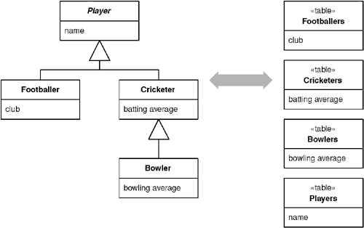
Pattern: Class Table Inheritance
Represents an inheritance hierarchy of classes with one table for each class.

Slide 47
Class Table Inheritance
Strengths
Weaknesses
You need to touch multiple tables to load an object, which means a join or multiple queries and sewing in memory.
Any refactoring of fields up or down the hierarchy causes database changes.
The supertype tables may become a bottleneck because they have to be accessed frequently.
The high normalization may make it hard to understand for ad hoc queries.
All columns are relevant for every row so tables are easier to understand and don't waste space.
The relationship between the domain model and the database is very straightforward.

Slide 48
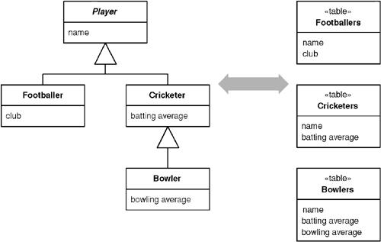
Pattern: Concrete Table Inheritance
Represents an inheritance hierarchy of classes with one table per concrete class in the hierarchy.

Slide 49
Concrete Table Inheritance
Strengths
Weaknesses
Primary keys can be difficult to handle.
If the fields on the domain classes are pushed up or down the hierarchy, you have to alter the table definitions. You don't have to do as much alteration as with Class Table Inheritance, but you can't ignore this as you can with Single Table Inheritance.
If a superclass field changes, you need to change each table that has this field because the superclass fields are duplicated across the tables.
A find on the superclass forces you to check all the tables, which leads to multiple database accesses (or a weird join).
Each table is self-contained and has no irrelevant fields. As a result it makes good sense when used by other applications that aren't using the objects.
There are no joins to do when reading the data from the concrete mappers.
Each table is accessed only when that class is accessed, which can spread the access load.

Slide 50
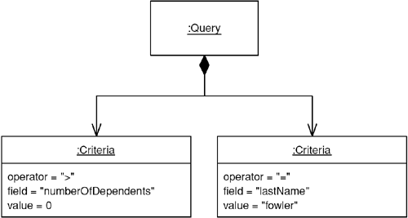
Pattern: Query Object
An object that represents a database query.

Slide 51
Queries
Supported query types:
Dynamic queries: consisting of a JPQL query string.
Named queries (static queries): static and unchangeable.
Native queries: to execute a native SQL statement.
Criteria API: object-oriented query API.
Entity Manager has Methods for Creating Queries (or typed queries).
Executing and controlling query made through the query interface APIs.

Slide 52
JPQL
A query language that takes its roots in the syntax of SQL.
The main difference is that in JPQL the results obtained are entity or a collection of entities.
Used to write dynamic queries: the query string may be dynamically created at runtime.
JPQL syntax is object oriented .
Example:
Query query = em.createQuery("SELECT c FROM
Customer c WHERE c.firstName=:fname");
query.setParameter("fname", "Ahmed");
List<Customer> customers =
query.getResultList();

Slide 53
Named Queries
Defined by annotating an entity with the @NamedQuery annotation.
Example:
To use this query
Can be more efficient to execute.
@NamedQuery
(name = "findCityCustomers",query="select c from Customer c where c.Address.city = :city);
Query query = em.createNamedQuery(" findCityCustomers ");
query.setParameter("city ", “Cairo");
List<Customer> customers = query.getResultList();

Slide 54
Native Queries
The creator method takes a native SQL statement as the parameter and return a Query instance .
Use the real database tables names. The result can be automatically converted back to entities.
Example:
Can use annotations to define static SQL queries. Named, native queries defined using the @NamedNativeQuery annotation on any entity.
Query query = em.createNativeQuery("SELECT * FROM t_customer”,
Customer.class);
List<Customer> customers = query.getResultList();
@NamedNativeQuery(name = "findAll",
query="select * from t_customer ")

Slide 55
Criteria API
Supports everything JPQL can do but with an object-based syntax.
The idea is that all the JPQL keywords (SELECT, WHERE, LIKE, GROUP BY…) are defined in this API.
Supposed to help writing non error prone statements.
Example:
CriteriaBuilder builder = em.getCriteriaBuilder();
CriteriaQuery<Customer> query = builder.createQuery(Customer.class);
Root<Customer> c = query.from(Customer.class);
query.select(c).where(builder.equal(c.get("firstName"), “Joe"));

Slide 56
Data Access Architecture Patterns
Key architecture patterns used in the implementation of a data access layer:
Table Data Gateway (aka Data Access Object)
Row Data Gateway
Active Record
Notes:
Of the three patterns, Table Data Gateway is probably the most common.
The data access architecture patterns mention here come from Patterns of Enterprise Application Architecture, Fowler.
DAO is probably a better name because it suggests an interface onto any type of persistent store, not just relational. I’ll use the term Table Data Gateway because it is more consistent with other two patterns discussed.

Slide 57
Table data gateway (aka DAO)
Realizing DAOs with JPA

Slide 58
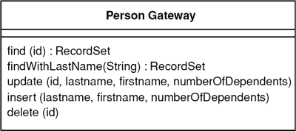
Table Data Gateway (aka Data Access Object)
Notes:
Most popular.

Slide 59
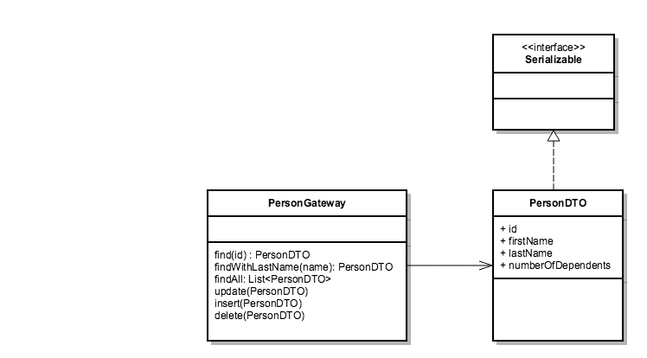
DAO with Data Transfer Object
We can use our JPA entity.
Notes:
Most popular.

Slide 60
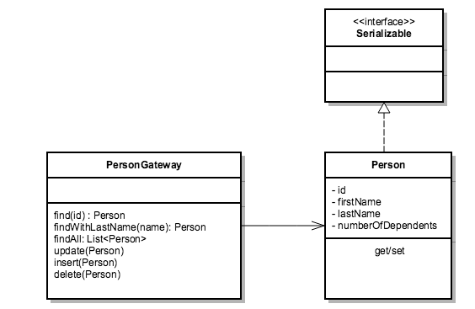
DAO with Data Transfer Object
Notes:
Most popular.

Slide 61
DAO in code: JPA Entity as DTO
@Entity @Table(name = "items") public class Item implements Serializable { @Id private Integer id; private String sku; private String category; private String title; public Item() { } // getters + setters }

Slide 62
DAO in code: using Java Generics
public interface DAO<T> { void add(T newEntity); void update(T updatedEntity); void remove(T entityToRemove); List<T> list(); T find(int id); }

Slide 63
DAO in code: Use EntityManager and Guice
Guice
JPA: EntityManager
JPA: Transaction. Needed when changing data
public class ItemJpaDAO implements DAO<Item> { @Inject private EntityManager em; public void add(Item entity) { em.getTransaction().begin();
em.persist(entity);
em.flush();
em.getTransaction().commit();
} ...
public List<Item> list() { Query query = em.createQuery( "SELECT e FROM Item e"); return (List<Item>) query.getResultList(); } }
JPA: Query

Slide 64
Resources
http://softwarecave.org/2014/08/02/primary-key-generators-in-jpa/
Patterns of Enterprise Application Architecture, Fowler
Hibernate ORM & JPA Overview, RedHat (Slideshare)
ORM, Ahmed Ramzy (Slideshare)

